Slide 1

First Design
Key board
R
L
S

Slide 2
Second Design
B
A

Slide 3
Third Design
Key board
B
C
D
B
A
C
D

Slide 4
1
1
0
1
2
3
1
0
1
4
5
6
0
1
1
7
8
9
1
1
1
1
1
1
1
0
1

Slide 5
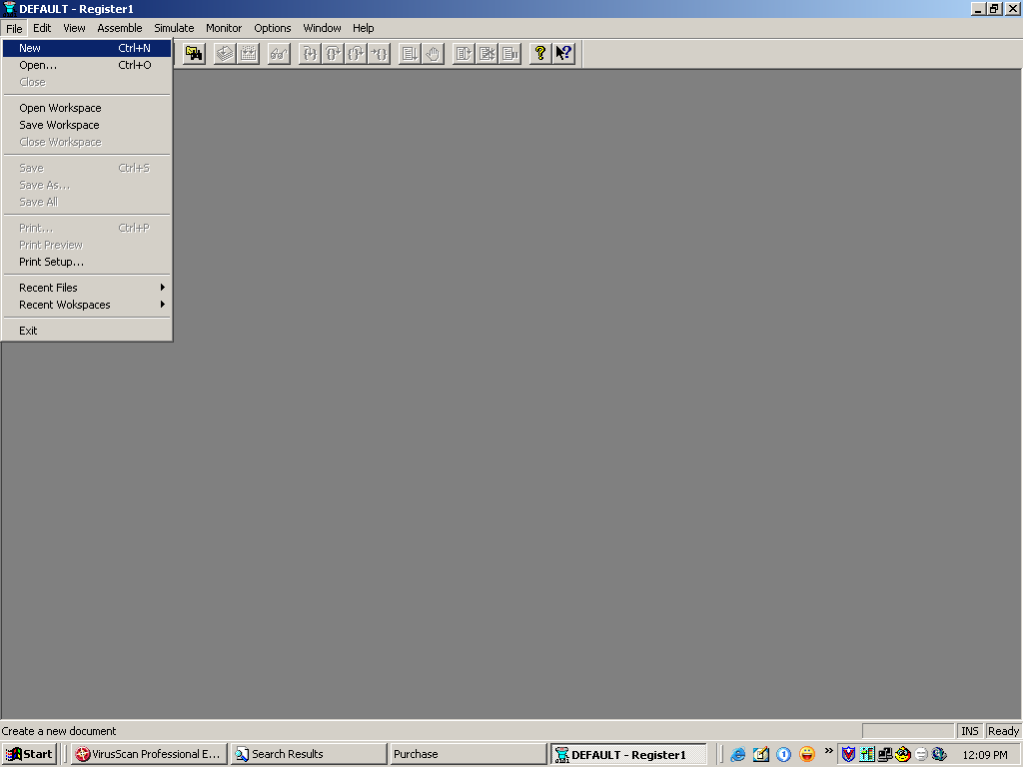

Slide 6
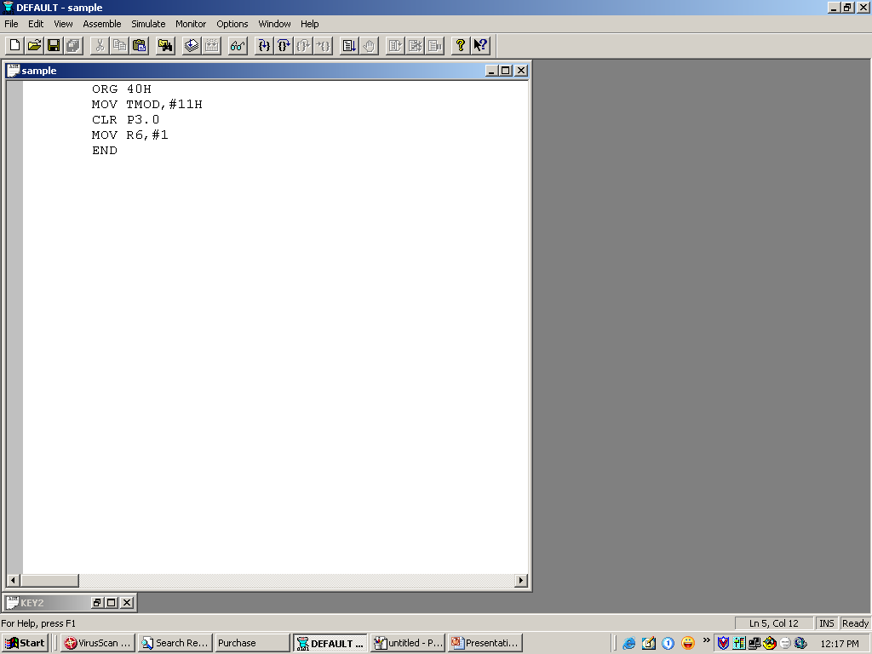

Slide 7
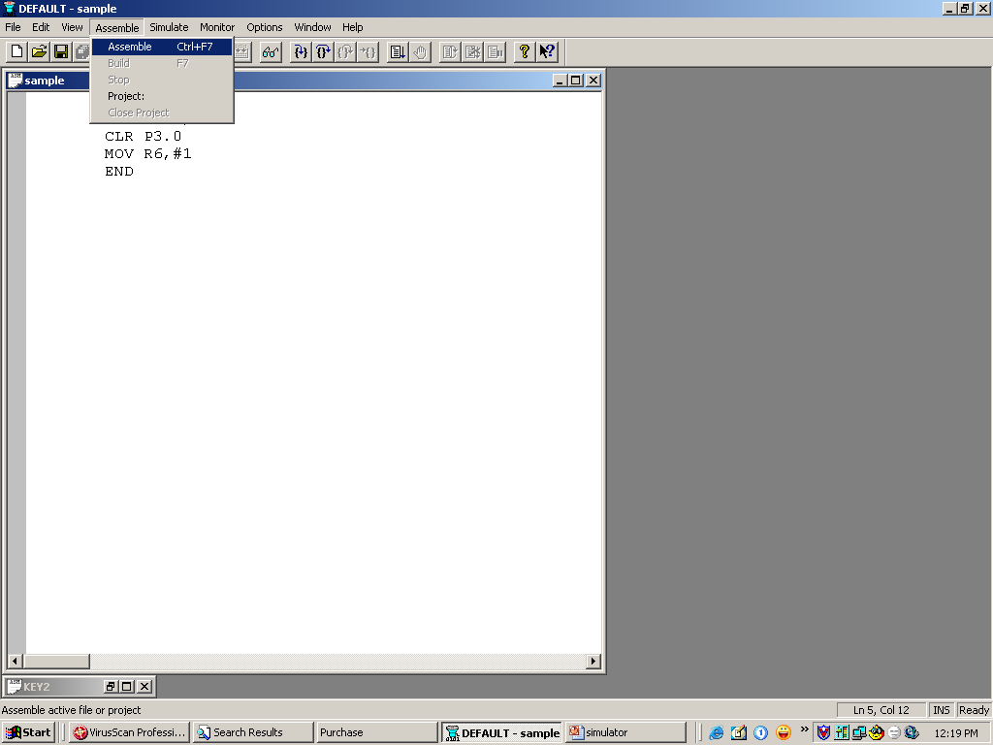

Slide 8
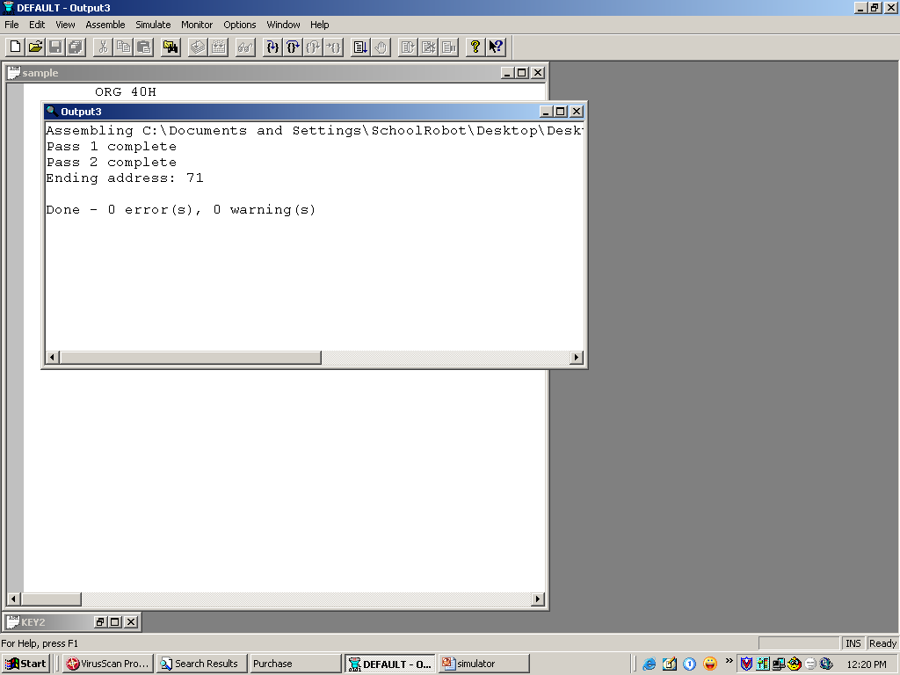

Slide 9
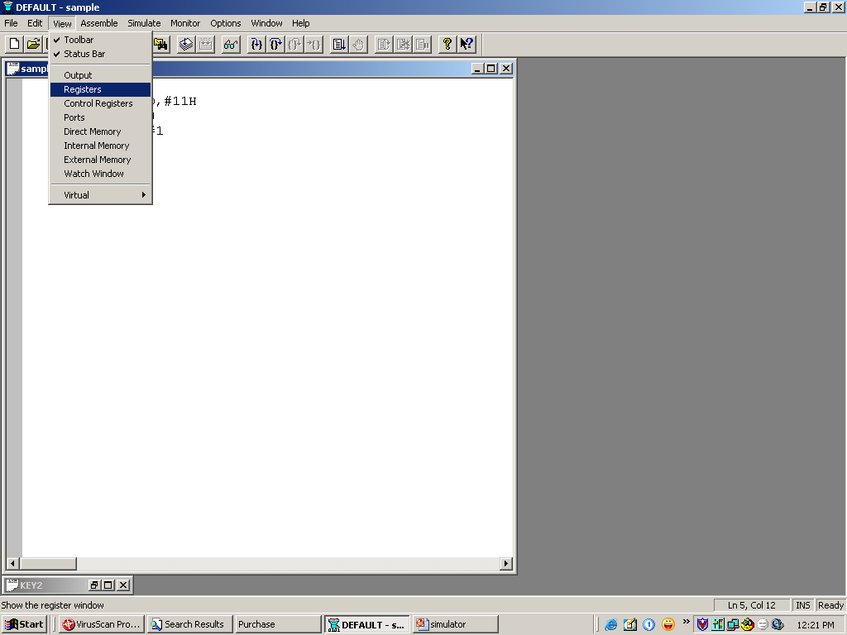

Slide 10
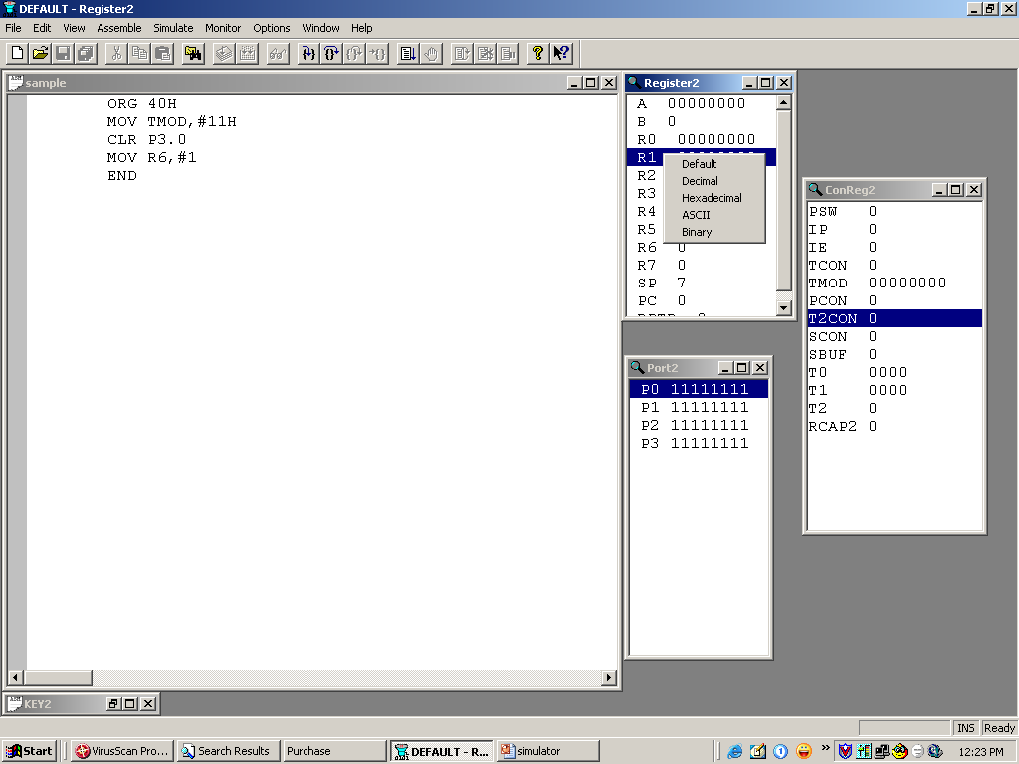

Slide 11
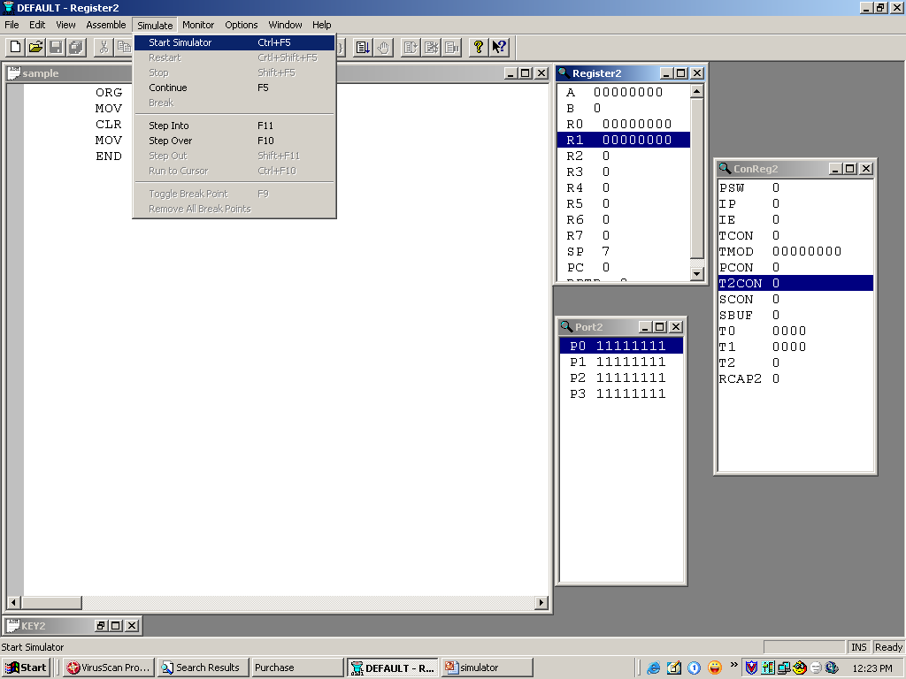

Slide 12
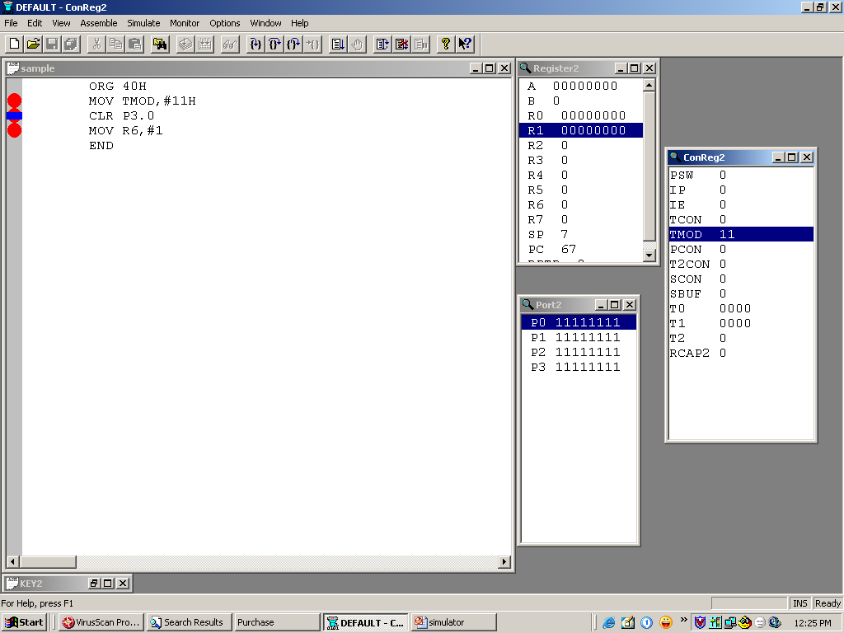

Slide 13
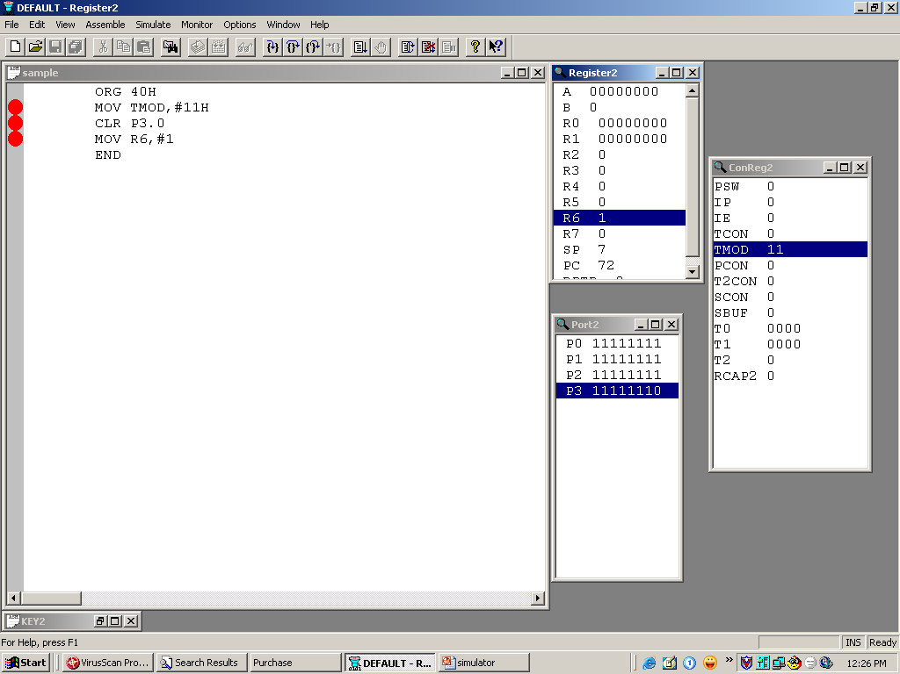

Slide 14
Microcontroller
8051

Slide 15
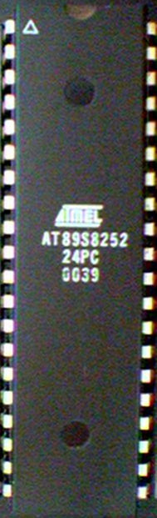

Contents:
Introduction
Block Diagram and Pin Description of the 8051
Registers
Memory mapping in 8051
Stack in the 8051
I/O Port Programming
Timer
Interrupt

Slide 16
Why do we need to learn Microprocessors/controllers?
The microprocessor is the core of computer systems.
Nowadays many communication, digital entertainment, portable devices, are controlled by them.
A designer should know what types of components he needs, ways to reduce production costs and product reliable.

Slide 17
Different aspects of a microprocessor/controller
Hardware :Interface to the real world
Software :order how to deal with inputs

Slide 18
The necessary tools for a microprocessor/controller
CPU: Central Processing Unit
I/O: Input /Output
Bus: Address bus & Data bus
Memory: RAM & ROM
Timer
Interrupt
Serial Port
Parallel Port

Slide 19
Microprocessors:
General-purpose microprocessor
CPU for Computers
No RAM, ROM, I/O on CPU chip itself
Example：Intel’s x86, Motorola’s 680x0
Many chips on mother’s board
Data Bus
CPU
General-Purpose Micro-processor
I/O Port
Serial COM Port
RAM
ROM
Timer
Address Bus
General-Purpose Microprocessor System
Notes:
Intel’s x86: 8086,8088,80386,80486, Pentium
Motorola’s 680x0: 68000, 68010, 68020,68030,6040

Slide 20
Microcontroller :
A smaller computer
On-chip RAM, ROM, I/O ports...
Example：Motorola’s 6811, Intel’s 8051, Zilog’s Z8 and PIC 16X
CPU
RAM
ROM
A single chip
Serial COM Port
I/O Port
Timer
Microcontroller

Slide 21
Microprocessor vs. Microcontroller
Microcontroller
CPU, RAM, ROM, I/O and timer are all on a single chip
fix amount of on-chip ROM, RAM, I/O ports
for applications in which cost, power and space are critical
single-purpose
Microprocessor
CPU is stand-alone, RAM, ROM, I/O, timer are separate
designer can decide on the amount of ROM, RAM and I/O ports.
expansive
versatility
general-purpose
Notes:
versatility 多用途的: any number of applications for PC

Slide 22
Block Diagram
External interrupts
On-chip ROM for program code
Timer/Counter
Interrupt Control
On-chip RAM
Timer 1
Counter Inputs
Timer 0
CPU
Bus Control
Serial Port
4 I/O Ports
OSC
P0 P1 P2 P3
TxD RxD
Address/Data

Slide 23

Pin Description of the 8051
P1.0
1
40
Vcc
P1.1
2
39
P0.0(AD0)
P1.2
3
38
P0.1(AD1)
P1.3
4
8051
(8031)
37
P0.2(AD2)
P1.4
5
36
P0.3(AD3)
P1.5
6
35
P0.4(AD4)
P1.6
7
34
P0.5(AD5)
P1.7
8
33
P0.6(AD6)
RST
9
32
P0.7(AD7)
(RXD)P3.0
10
31
EA/VPP
(TXD)P3.1
11
30
ALE/PROG
(INT0)P3.2
12
29
PSEN
(INT1)P3.3
13
28
P2.7(A15)
(T0)P3.4
14
27
P2.6(A14)
(T1)P3.5
15
26
P2.5(A13)
(WR)P3.6
16
25
P2.4(A12)
(RD)P3.7
17
24
P2.3(A11)
XTAL2
18
23
P2.2(A10)
XTAL1
19
22
P2.1(A9)
GND
20
21
P2.0(A8)


Slide 24

Figure (b). Power-On RESET Circuit
Vcc
+
10 uF
31
EA/VPP
30 pF
X1
19
11.0592 MHz
8.2 K
X2
30 pF
18
9
RST


Slide 25
Port 0 with Pull-Up Resistors
Vcc
10 K
Port 0
P0.0
DS5000
8751
8951
P0.1
P0.2
P0.3
P0.4
P0.5
P0.6
P0.7

Slide 26
Registers
A
B
R0
DPTR
DPH
DPL
R1
R2
PC
PC
R3
R4
Some 8051 16-bit Register
R5
R6
R7
Some 8-bitt Registers of the 8051

Slide 27
Stack in the 8051
7FH
The register used to access the stack is called SP (stack pointer) register.
The stack pointer in the 8051 is only 8 bits wide, which means that it can take value 00 to FFH. When 8051 powered up, the SP register contains value 07.
Scratch pad RAM
30H
2FH
Bit-Addressable RAM
20H
1FH
Register Bank 3
18H
17H
Register Bank 2
10H
0FH
(Stack) Register Bank 1
08H
07H
Register Bank 0
00H

Slide 28
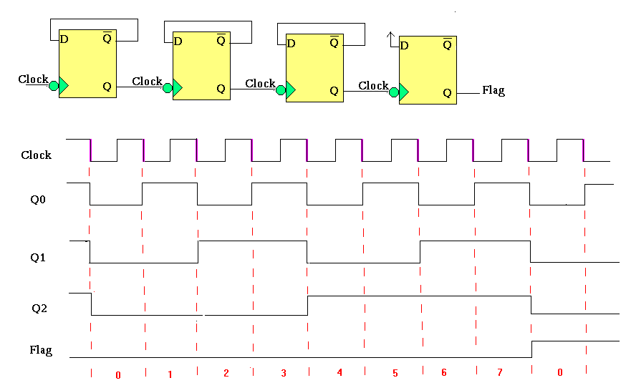
Timer :
Timer:
:

Slide 29
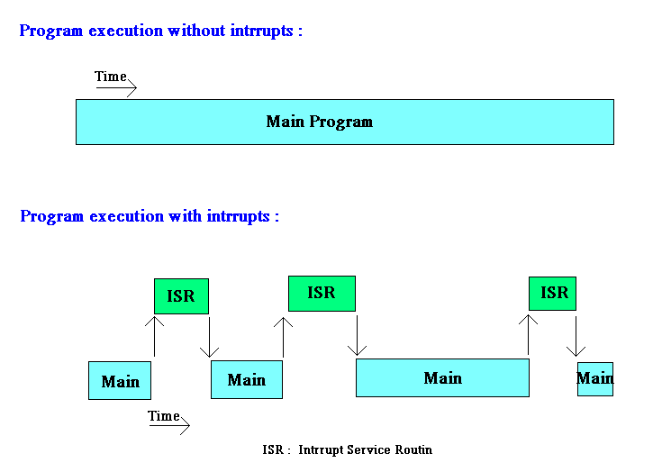
Interrupt :

Slide 30
Numerical Bases Used in Programming
Hexadecimal
Binary
BCD

Slide 31
Hexadecimal Basis
Hexadecimal Digits:
1 2 3 4 5 6 7 8 9 A B C D E F
A=10
B=11
C=12
D=13
E=14
F=15

Slide 32
Decimal, Binary, BCD, & Hexadecimal Numbers
(43)₁₀=
(0100 0011)_{BCD}=
( 0010 1011 )₂ =
( 2 B )₁₆

Slide 33
Register Addressing Mode
MOV Rn, A ;n=0,..,7
ADD A, Rn
MOV DPL, R6
MOV DPTR, A
MOV Rm, Rn

Slide 34
Direct Addressing Mode
Although the entire of 128 bytes of RAM can be accessed using direct addressing mode, it is most often used to access RAM loc. 30 – 7FH.
MOV R0, 40H
MOV 56H, A
MOV A, 4 ; ≡ MOV A, R4
MOV 6, 2 ; copy R2 to R6
; MOV R6,R2 is invalid !

Slide 35
Immediate Addressing Mode
MOV A,#65H
MOV R6,#65H
MOV DPTR,#2343H
MOV P1,#65H

Slide 36
SETB bit ; bit=1
CLR bit ; bit=0
SETB C ; CY=1
SETB P0.0 ;bit 0 from port 0 =1
SETB P3.7 ;bit 7 from port 3 =1
SETB ACC.2 ;bit 2 from ACCUMULATOR =1
SETB 05 ;set high D5 of RAM loc. 20h
Note:
CLR instruction is as same as SETB
i.e.:
CLR C ;CY=0
But following instruction is only for CLR:
CLR A ;A=0

Slide 37
DEC byte ;byte=byte-1
INC byte ;byte=byte+1
INC R7
DEC A
DEC 40H ; [40]=[40]-1

Slide 38
LOOP and JUMP Instructions
Conditional Jumps :
JZ | Jump if A=0
JNZ | Jump if A/=0
DJNZ | Decrement and jump if A/=0
CJNE A,byte | Jump if A/=byte
CJNE reg,#data | Jump if byte/=#data
JC | Jump if CY=1
JNC | Jump if CY=0
JB | Jump if bit=1
JNB | Jump if bit=0
JBC | Jump if bit=1 and clear bit

Slide 39
Call instruction
SETB P0.0
.
.
CALL UP
.
.
.
CLR P0.0
.
.
RET
UP:

